Slide 1

Showcase and implementation of A* algorithm
Cojocariu Andrei
Vladescu Sorin-Adrian

Slide 2



Summary
1) Introduction
2) Matrix definition and construction
3) A* algorithm implementation
4) Classes and methods
5) How it works
6) Statistics
7) Conclusions

Slide 3




Introduction
In order to implement the algorithm, the best option was to split the code in smaller parts (Matrix construction, A* implementation, additional definition of methods and functions)

Slide 4

Topic one
Matrix definition and construction

Slide 5
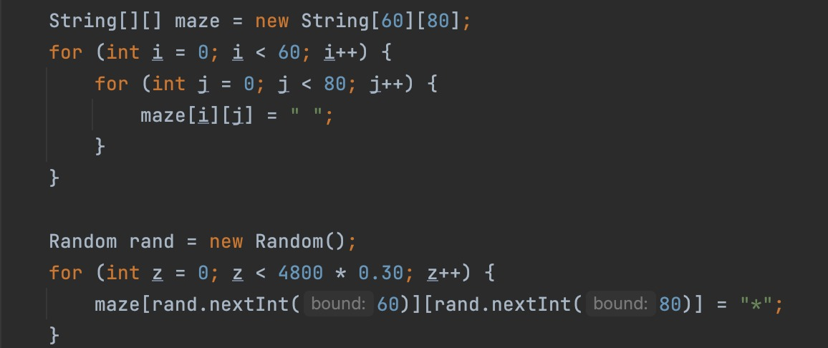
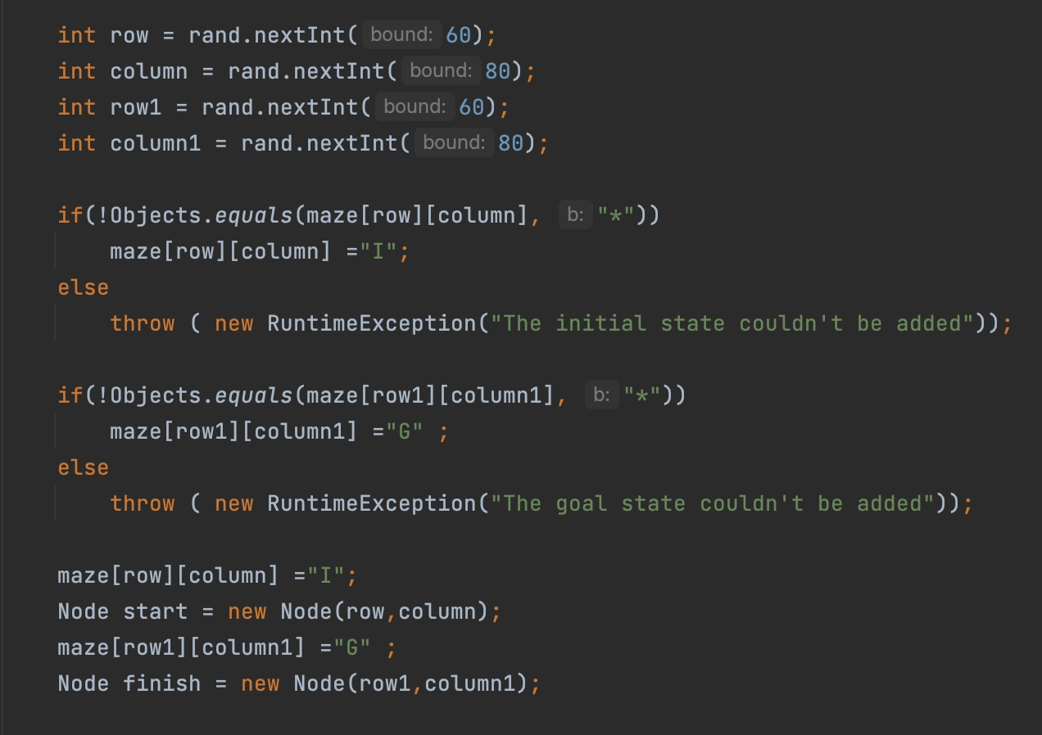
Matrix definition and construction
Figure 1
Figure 1: Creates a 60x80-element matrix and places random obstacles on it
Figure 2: Creates I and G points (RuntimeException if the points are placed on obstacles) and assigns them to be Nodes (start & finish)
Figure 2

Slide 6
Topic two
A* algorithm implementation

Slide 7
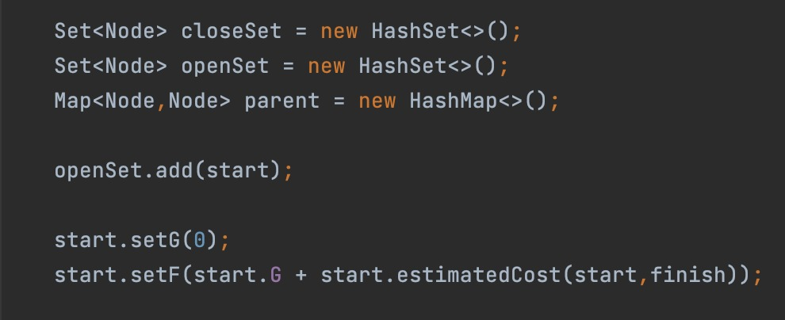
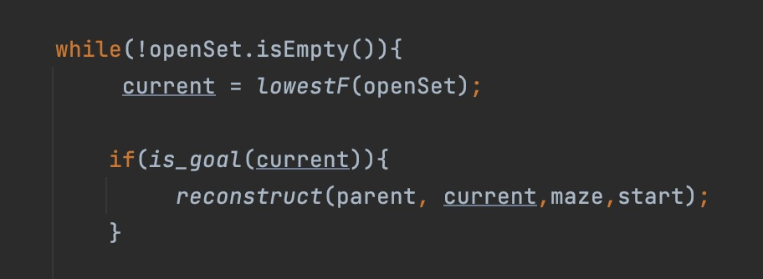
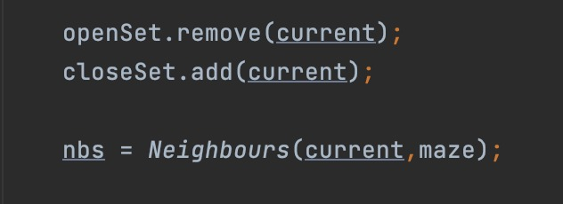
A* implementation
Figure 3: Definition of Openset, ClosedSet, Parent map
Figure 4,5: Implementation of A* algorithm pseudocode
Figure 3
Figure 4
Figure 5

Slide 8
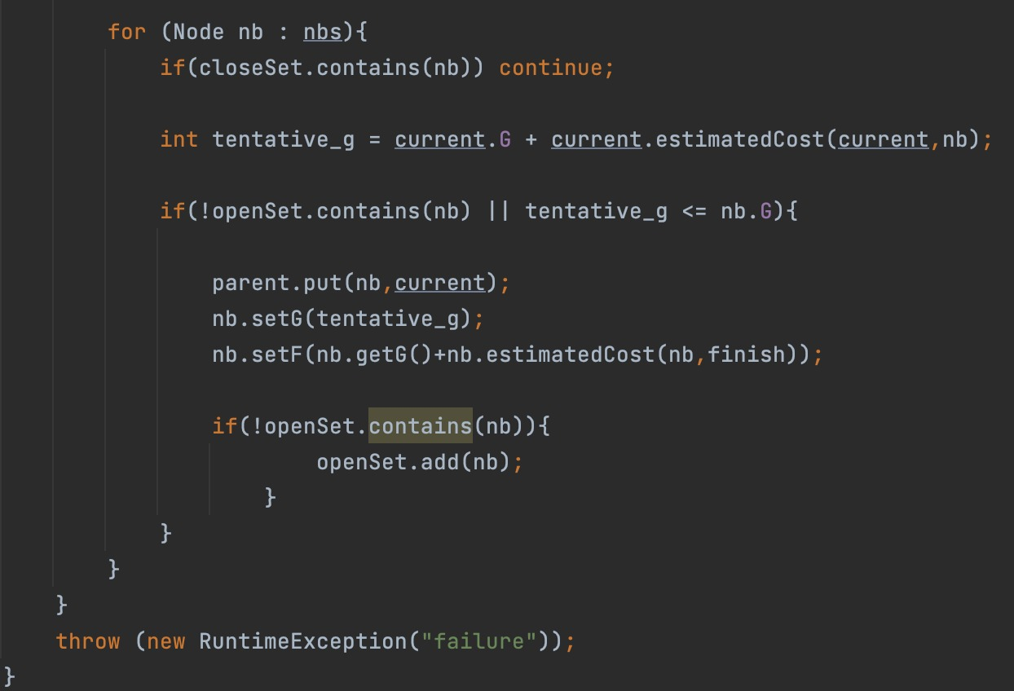
A* implementation
Figure 6: Implementation of A* algorithm pseudocode
Figure 6: Implementation of A* algorithm pseudocode
Figure 6

Slide 9
Topic three
Classes and methods

Slide 10
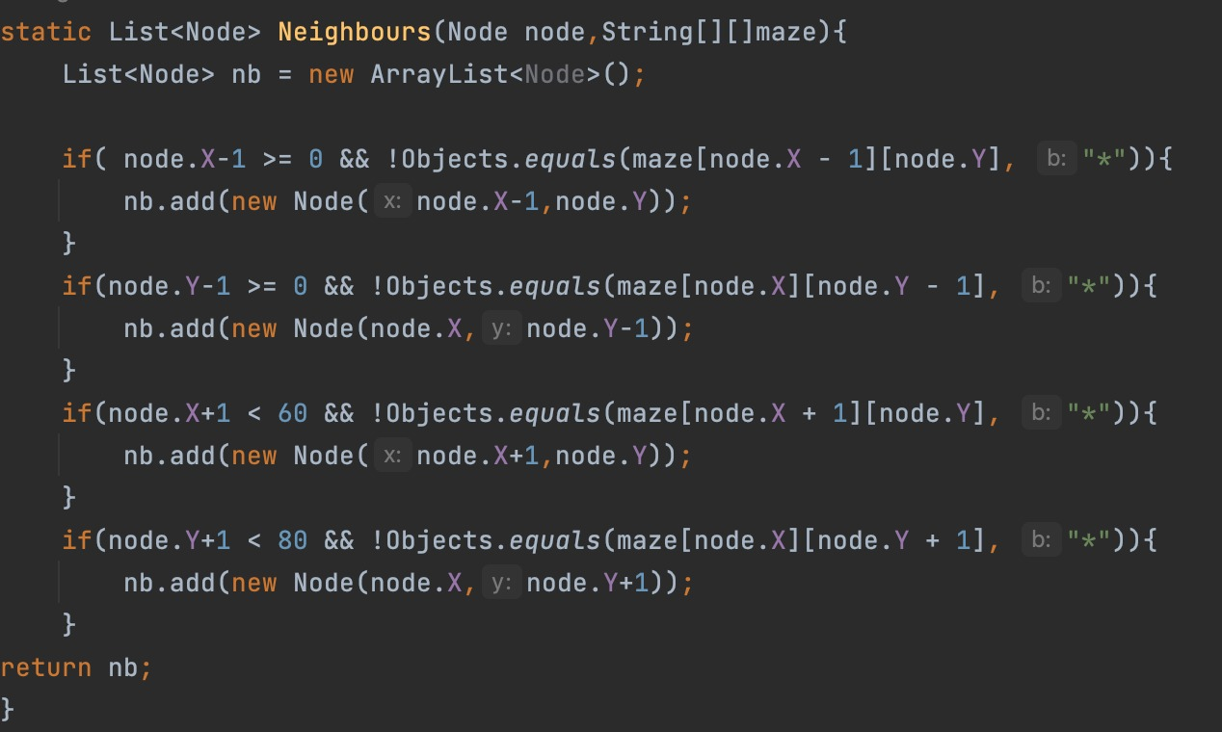
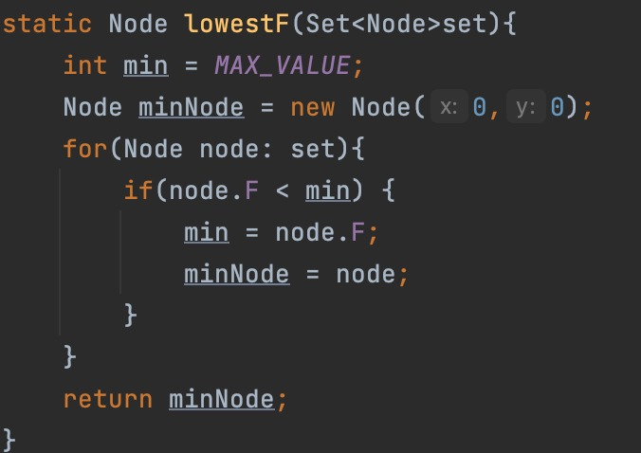
Classes and methods
Figure 7
Figure 8
Figure 7: Verifies if current Node has neighbors and add them to the list of neighbors
Figure 8: Calculates the lowest f value of Nodes contained by a Set

Slide 11
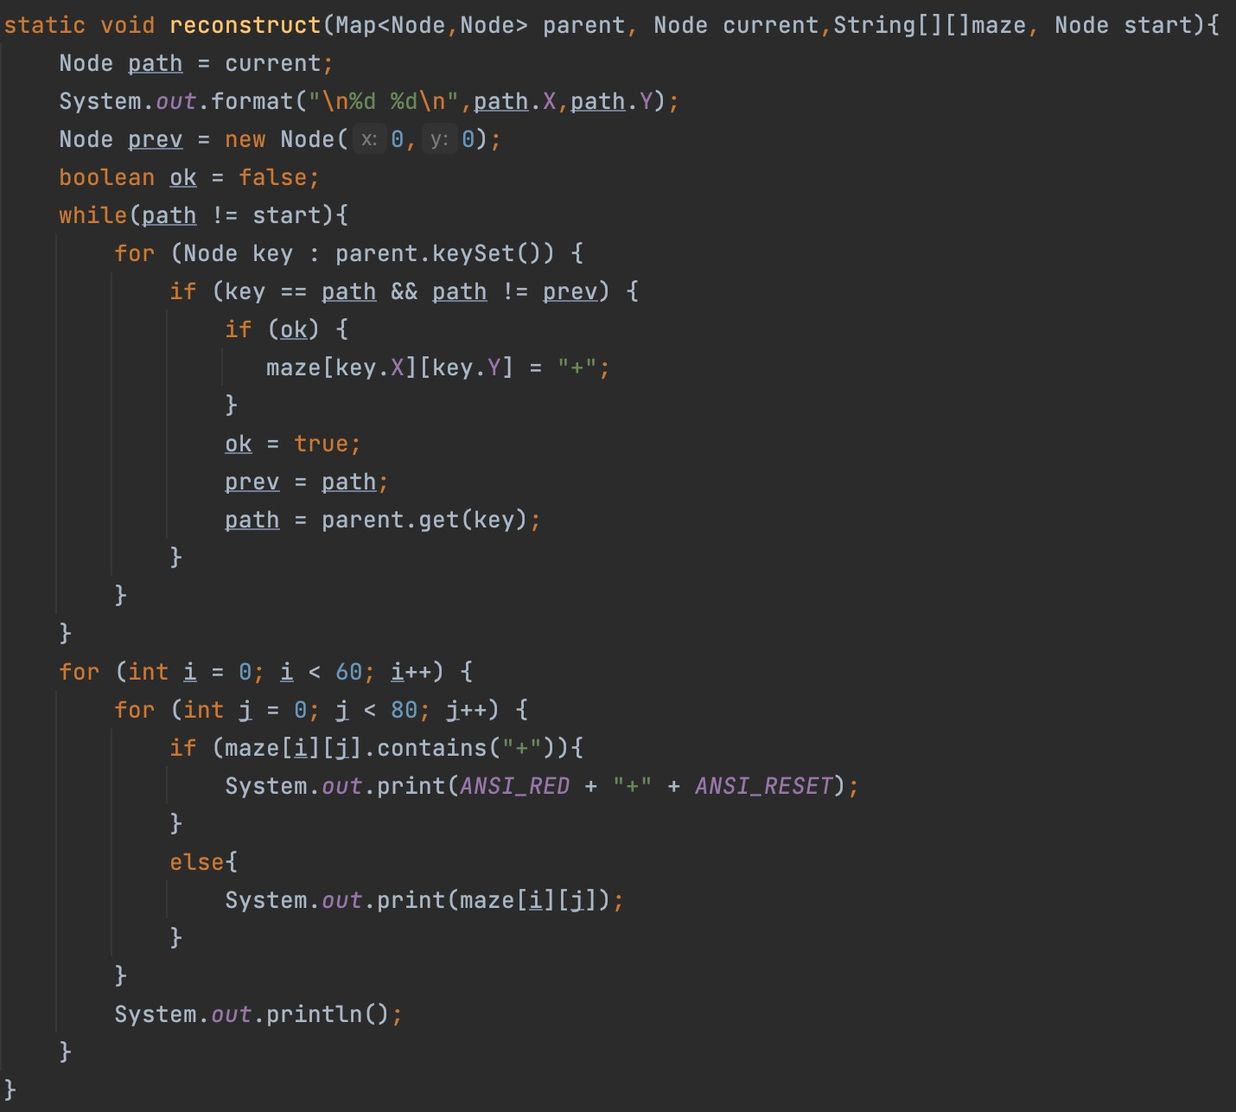
Classes and methods
Figure 9: Reconstructs the optimal path in the end when an optimal way has been found
Figure 9

Slide 12
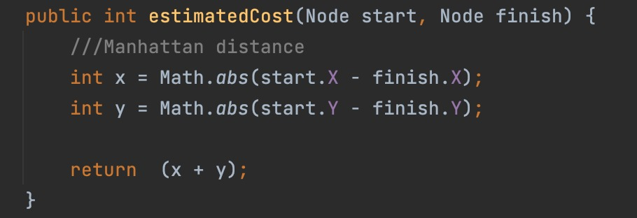
Classes and methods
Figure 10
Figure 10: Node class method that implements the heuristic function h using the Manhattan Distance

Slide 13

How it works?

Slide 14
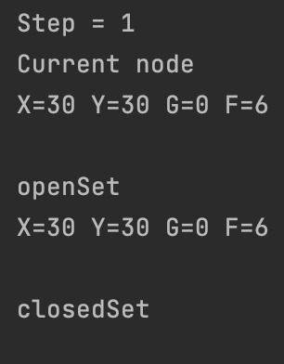
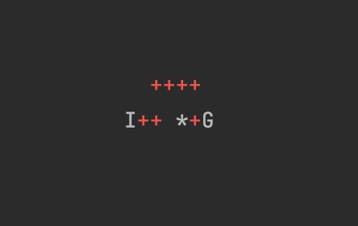
To understand the functionality of the algorithm, we will present the first 3 steps of it
How it works

Slide 15
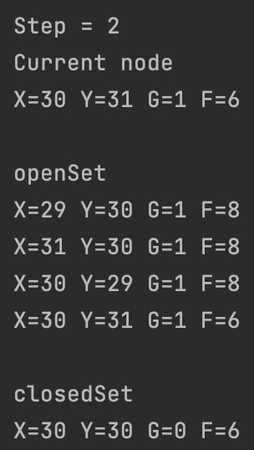
Step 2: Current takes the Node from the OpenSet with the lowest f value
How it works

Slide 16
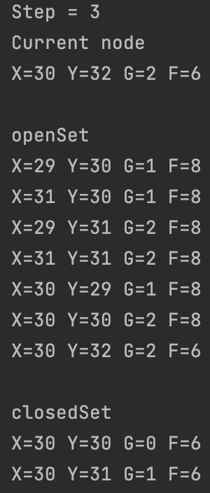
How it works
Step 3:
We move the previous Current Node to the ClosedSet and repeat Step 2

Slide 17

In a more complex simulation, the algorithm will find the optimal path from initial state to the goal (If there is any)
How it works

Slide 18
Topic four (optional)
How reliable is it?

Slide 19
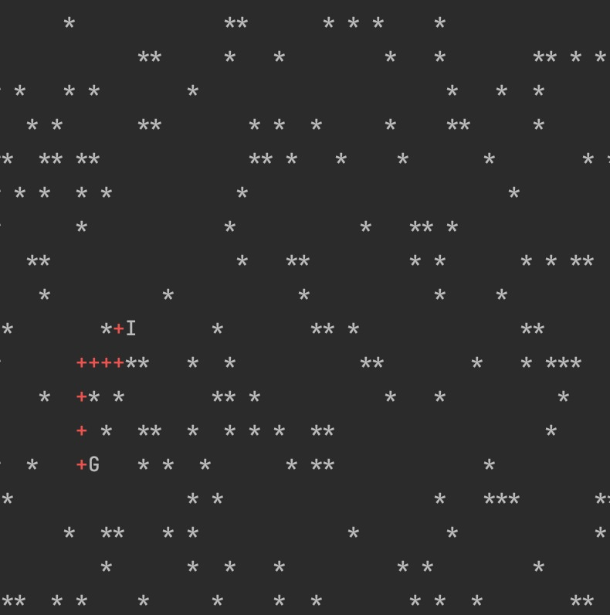



20% obstacles
30% obstacles
40% obstacles
50% obstacles

Slide 20
We conducted 100 tests for each obstacle percentage in order to see how effective is our implementation of the algorithm. Starting with 20% obstacles on the map, the results are:
Statistics
Obstacles (%) | Couldn’t find a path (Error count) | η Efficiency (%)
20% | 54 | 46%
30% | 61 | 39%
40% | 71 | 29%
50% | 93 | 7%
60% | 98 | 2%

Slide 21

Conclusions
A* algorithm is a powerful searching algorithm used in various applications such as maps. In maps, the algorithm is used to calculate the shortest distance between the source (initial state) and the destination (final state).

Slide 22


Thank You!
Cojocariu Andrei
Vladescu Sorin-Adrian
E.T.S. de Ingeniería Informática,
Universidad de Málaga

